Slide 1



Understanding CSV Files
A Simple and Structured Way to Store and Exchange Data

Slide 2



Contents
What is a CSV file?
Some examples of csv . Files
Advantages and disadvantages
When to Use CSV files?
How to Use CSV files?

Slide 3


What is a CSV file?
CSV stands for Comma-Separated Values.
It is a file format used for storing and exchanging data in a simple and structured way.
CSV files are plain text files that contain a table of data, where each row represents a record and each column represents a field in that record.
The values in each cell are separated by commas, hence the name.
CSV files are a widely used and supported format, and can be opened by many different programs, including spreadsheet software, database management systems, and programming languages.

Slide 4
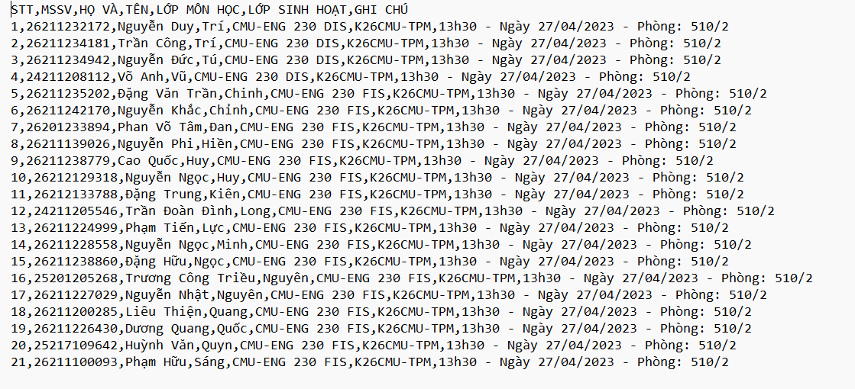

Some examples of csv files
This is a csv file opened with notepad application

Slide 5

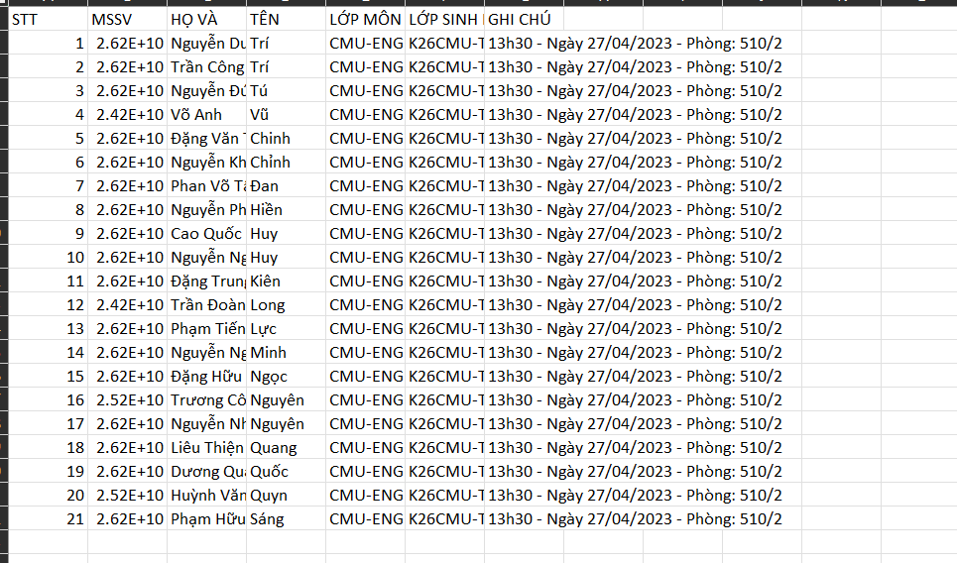
This is a csv file opened with Excel application

Slide 6

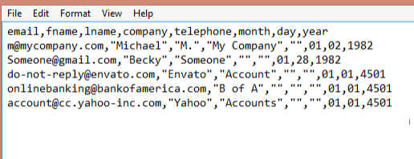
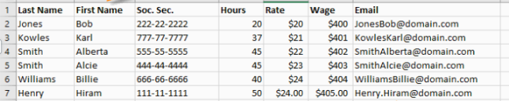
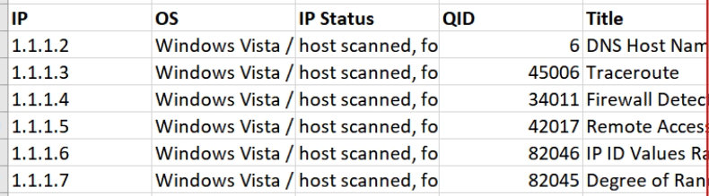

Slide 7
Advantages
Simple: CSV file has a simple format, just use commas to separate data fields, easy to understand and use.
Compatibility: CSV files are supported by most data analysis tools and applications, such as spreadsheets (such as Microsoft Excel, Google Sheets), databases, programming languages (such as Python) and data analysis tools.
Small size: CSV is a plain text format, so CSV files are often smaller in size than other data formats, like Excel files or databases.

Slide 8
Disadvantages
Does not support complex data types: CSV only supports storing data in text format, cannot store complex data types such as date and time, objects or binary data.
Lack of data normalization: CSV does not have strict conventions on data structures, adding/removing data fields or changing data structures in CSV files can lead to errors or loss of information.
No relational model integration: CSV does not support relational models such as foreign keys or constraints, so performing complex operations such as querying data from multiple tables can become difficult.

Slide 9
Where is the csv file different from the xml file?
Data Format
Datatypes
Functions and features
File size
Application

Slide 10
When to Use CSV files
SHARE DATA BETWEEN DIFFERENT APPLICATIONS.
STORE DATA IN A SIMPLE AND COMPACT FORMAT.
CSV is a commonly used data file format that is supported by most applications such as spreadsheets, databases, programming languages, etc.Therefore, if you need to share data between different applications, CSV file can be an effective solution.
CSV is a simple format, containing only plain text and values separated by commas. Therefore, CSV files are much smaller in size compared to other complex data file formats, saving disk space and reducing load times.
IMPORT DATA INTO A SYSTEM OF AN APPLICATION.
PROCESS LARGE AMOUNTS OF DATA EFFICIENTLY.
CSV is a simple text file format, making data processing faster and more efficient compared to other complex data file formats. This is particularly useful when you need to process large amounts of data, as CSV files help reduce data processing time and optimize system performance.
CSV files can be used to import data into a system of an application, such as a database or spreadsheet. With CSV files, you can easily and quickly import data using the file import functions of the application.

Slide 11
Demo Use CSV files?

